Slide 1
Find Difference Between Images
Speaker :Peter Guan

Slide 2
Find Difference Between Images
Problem Analysis
Experimental Procedure
Future Work
Reference

Slide 3
Find Difference Between Images
Problem Analysis
Experimental Procedure
Future Work
Reference

Slide 4
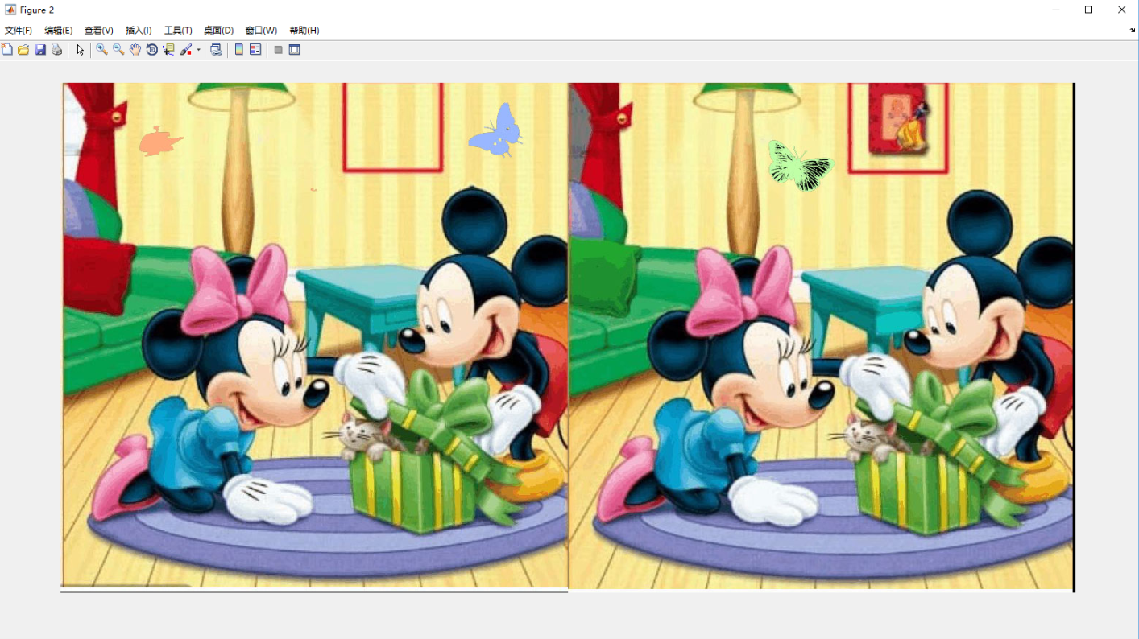
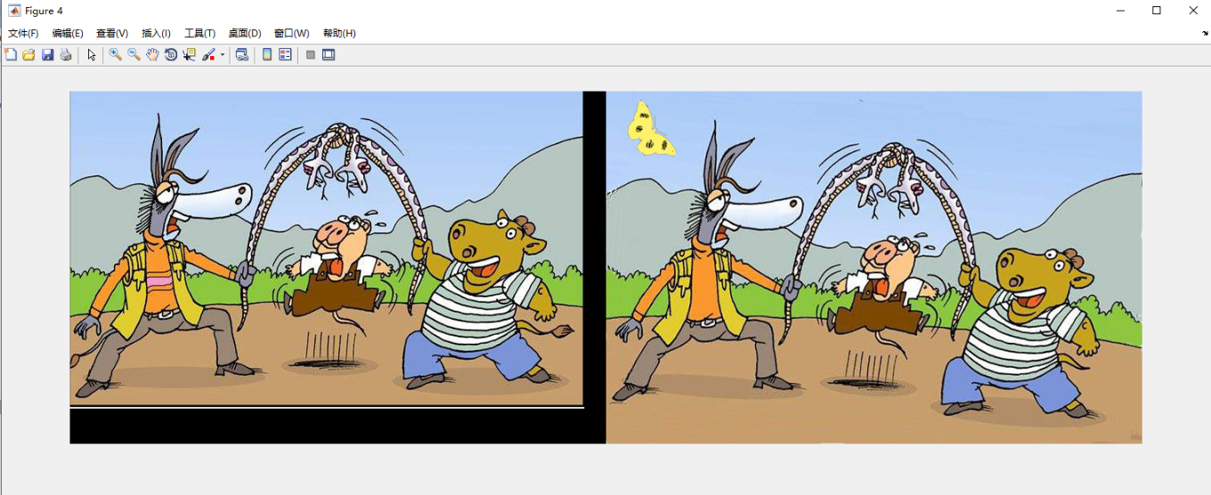
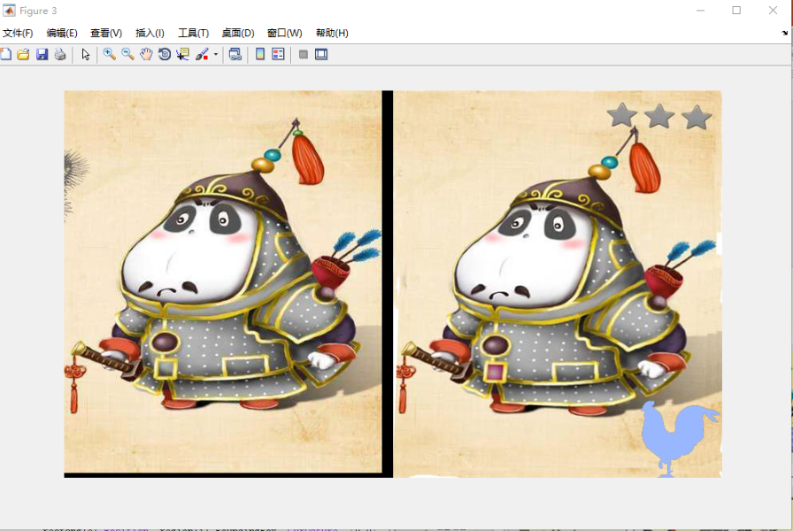
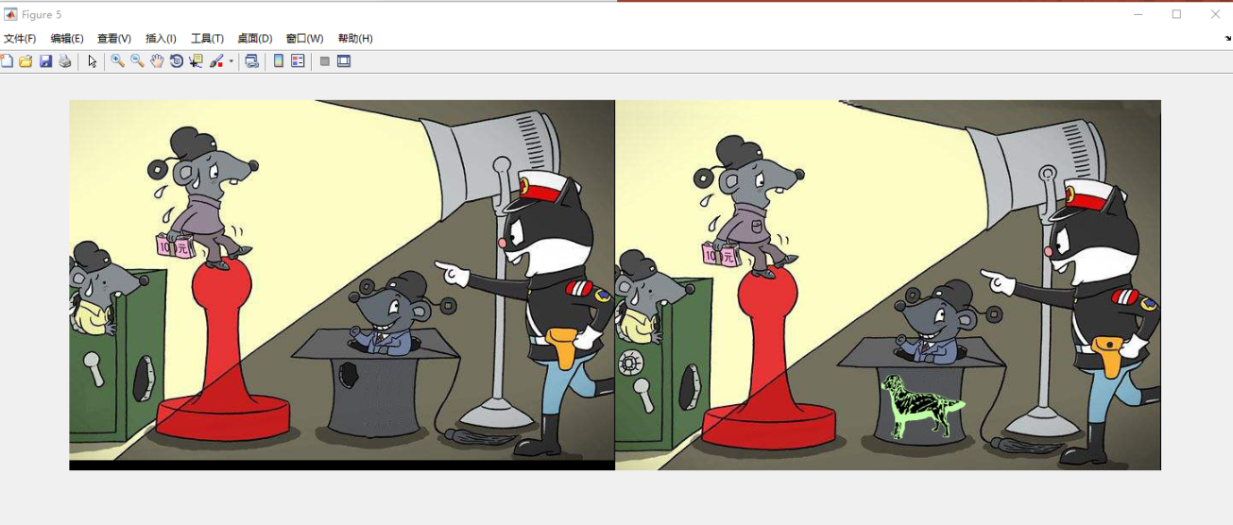
Problem Analysis

Slide 5
Difference Between Two Image
Translation
Shape
Rotation
Color
Image Registration
Feature Detection

Slide 6
Find Difference Between Images
Problem Analysis
Experimental Procedure
Future Work
Reference

Slide 7
Image Registration
Step 1:Sift Algorithm to Find the matched Key Points
Step 2: Outlier detection method based on Unary Normal Distribution
Step 3 : Calculate Transformational Matrix
Step 4 : Transform the moving image

Slide 8
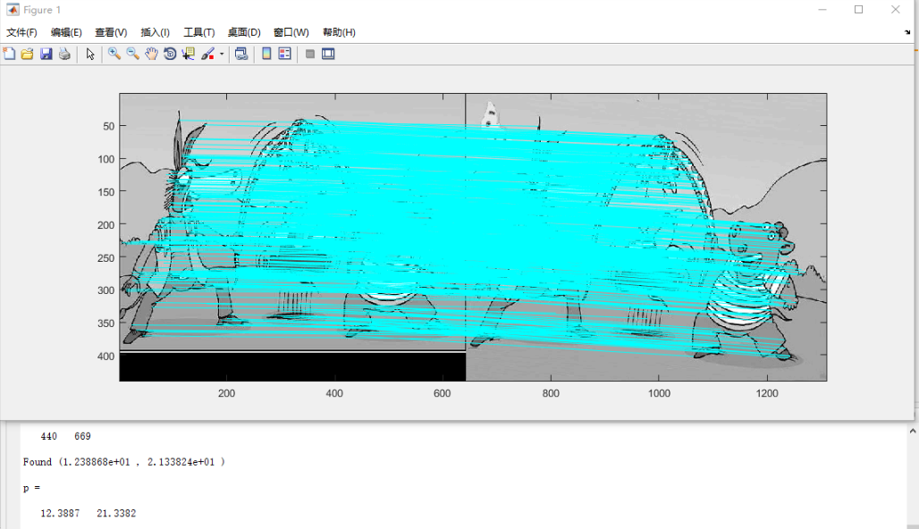
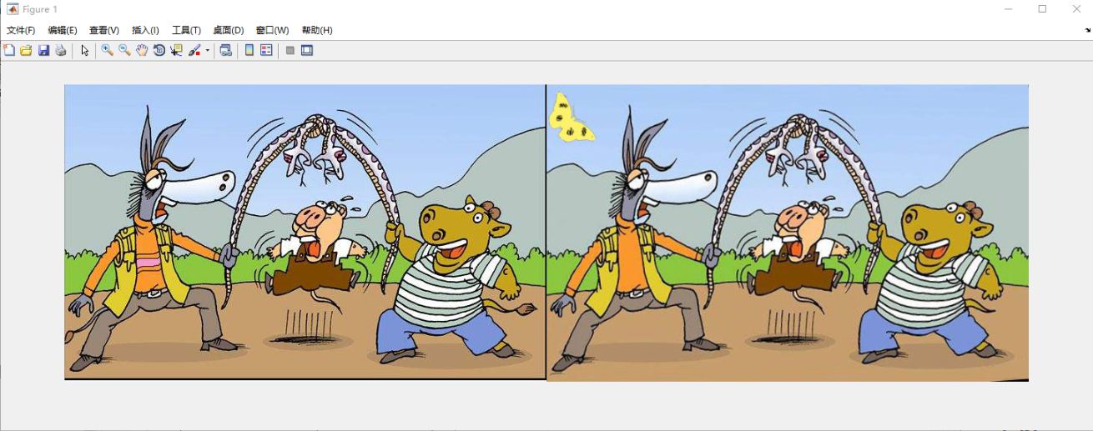
Image Registration

Slide 9
Target Detection(Gary Level)
Homomorphic Filter
(a)It simultaneously normalizes the brightness across an image and increases contrast. Here homomorphic filtering is used to remove multiplicative noise
(b) Homomorphic filtering is used for correcting non-uniform illumination in image, and the image become clearer than the original image

Slide 10
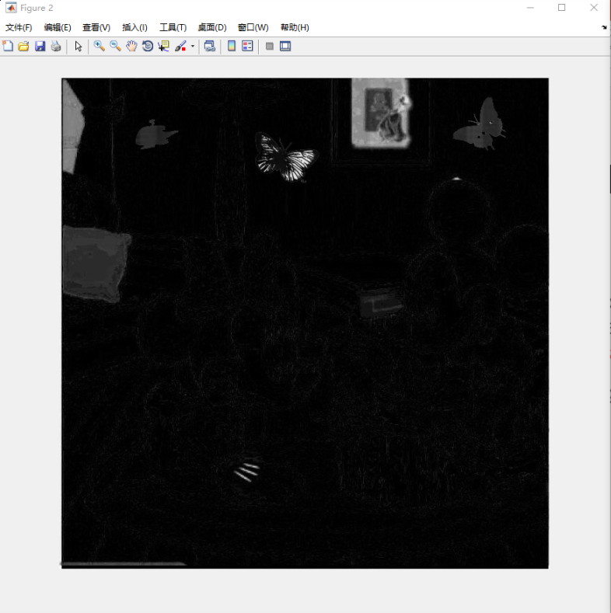
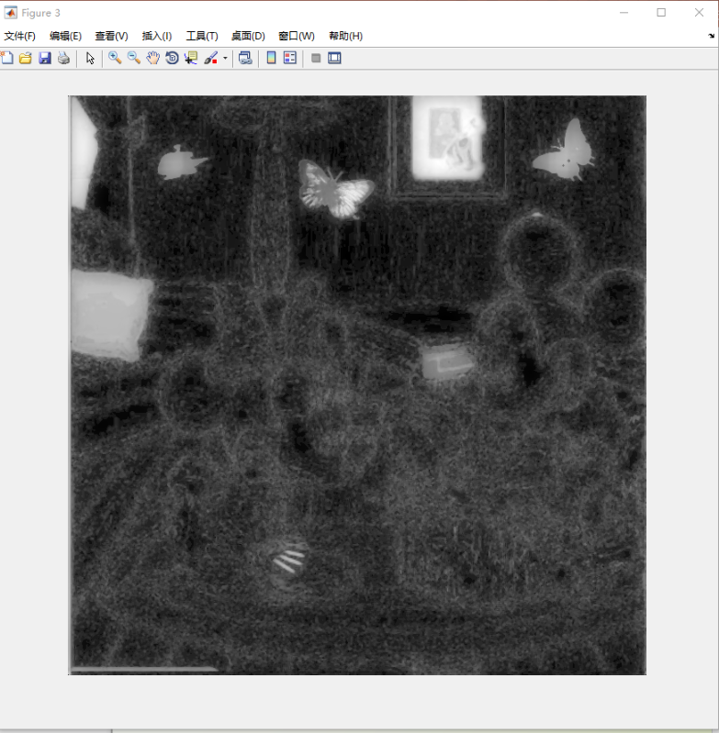
Target Detection(Gary Level)

Slide 11
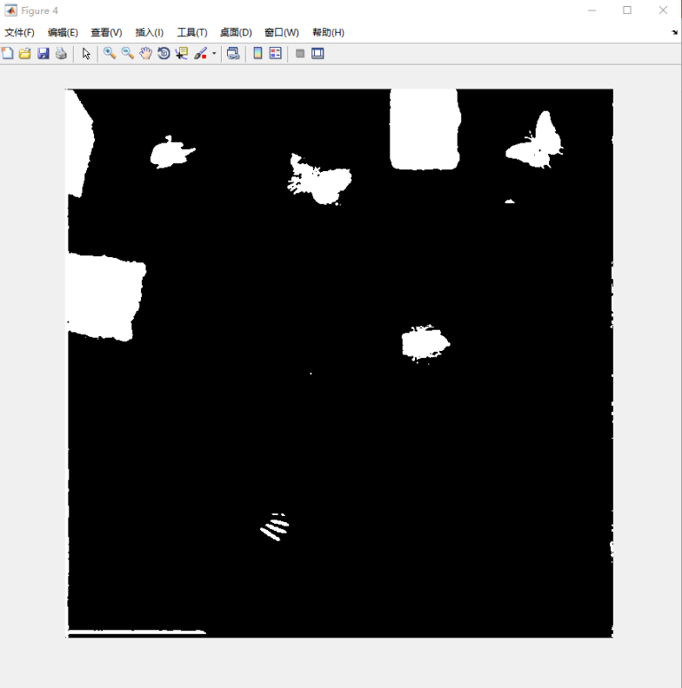
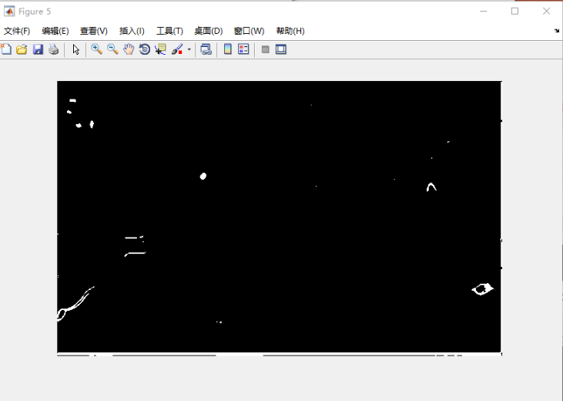
Target Detection(GRAY Level)

Slide 12
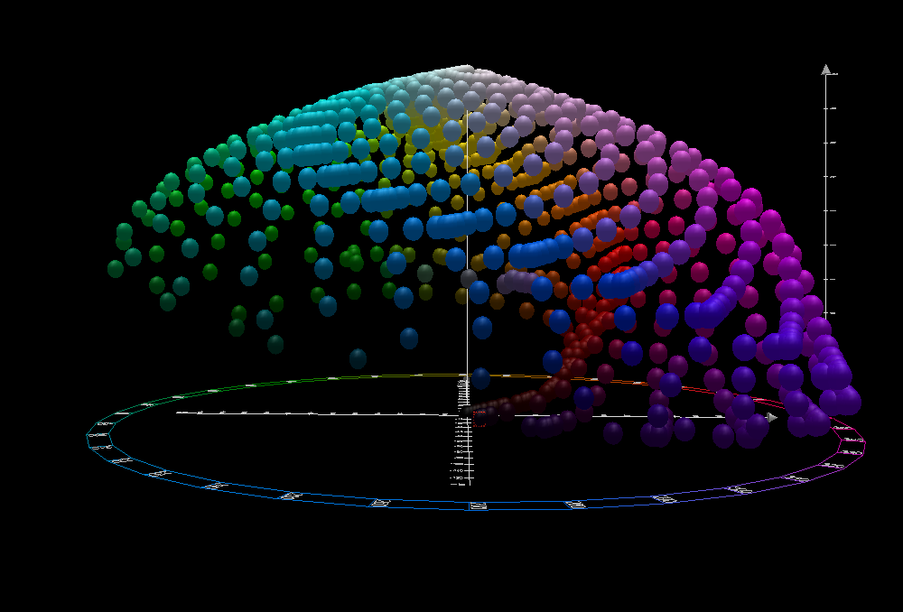
Target Detection(LAB Level)
LAB Color Space
(a) three numerical values
L* for the lightness
a* for the green–red color components
b* for the blue–yellow color components.
(b) distinguishing feature
Designed to be perceptually uniform with respect to human color vision, meaning that the same amount of numerical change in these values corresponds to about the same amount of visually perceived change.

Slide 13
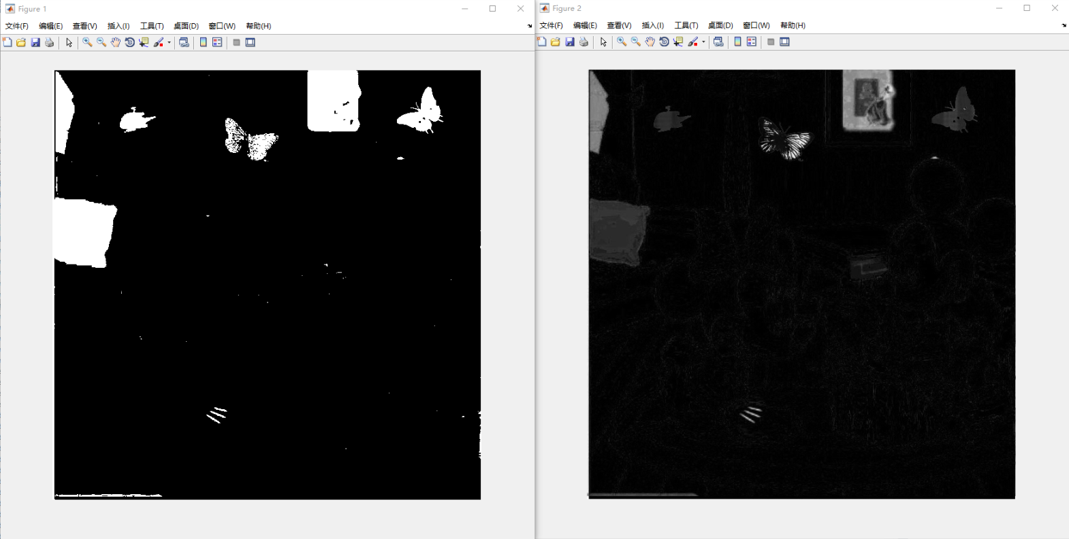
Target Detection(LAB Level)

Slide 14
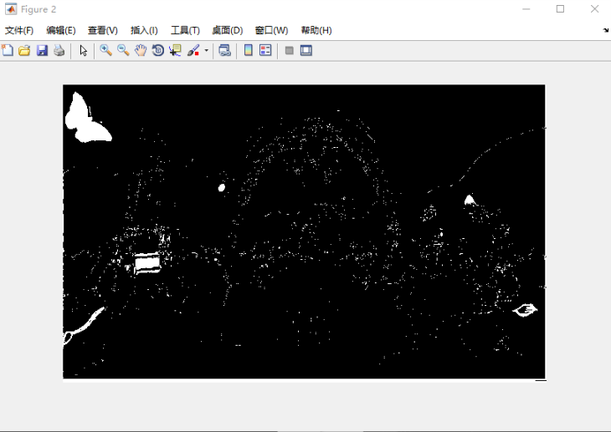
Target Detection(reconstruct)
LAB Image
Gray Image
mask

Slide 15
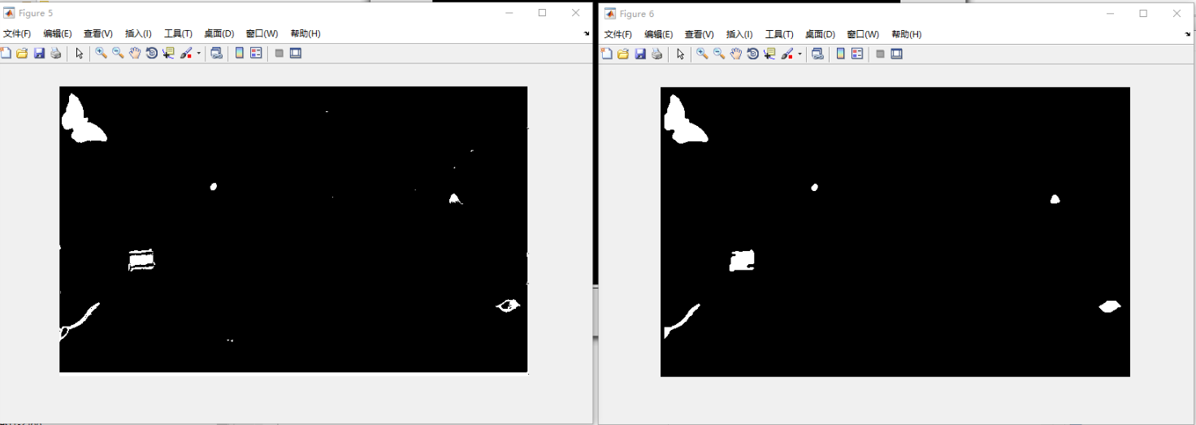
Target Detection(Denoise)

Slide 16
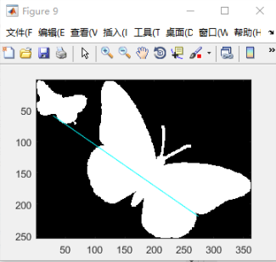
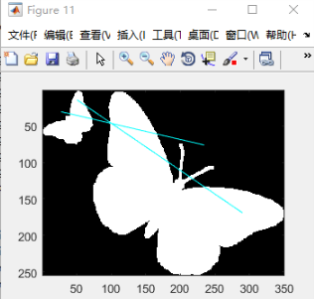
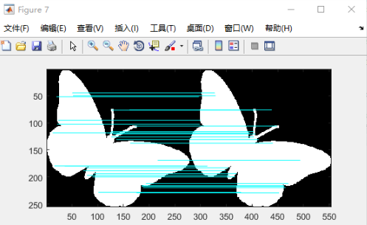
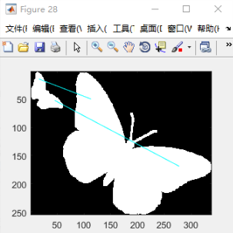
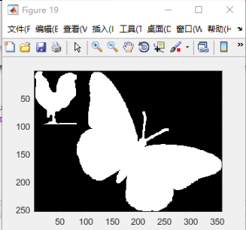
Target Matching
Sift Algorithm to Find the matched Key Points

Slide 17
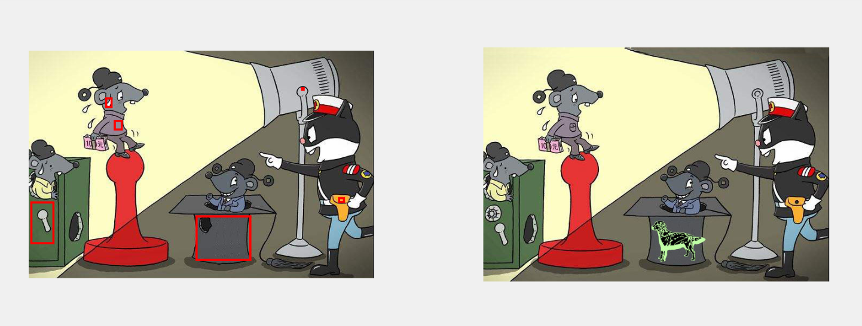
Target Matching

Slide 18
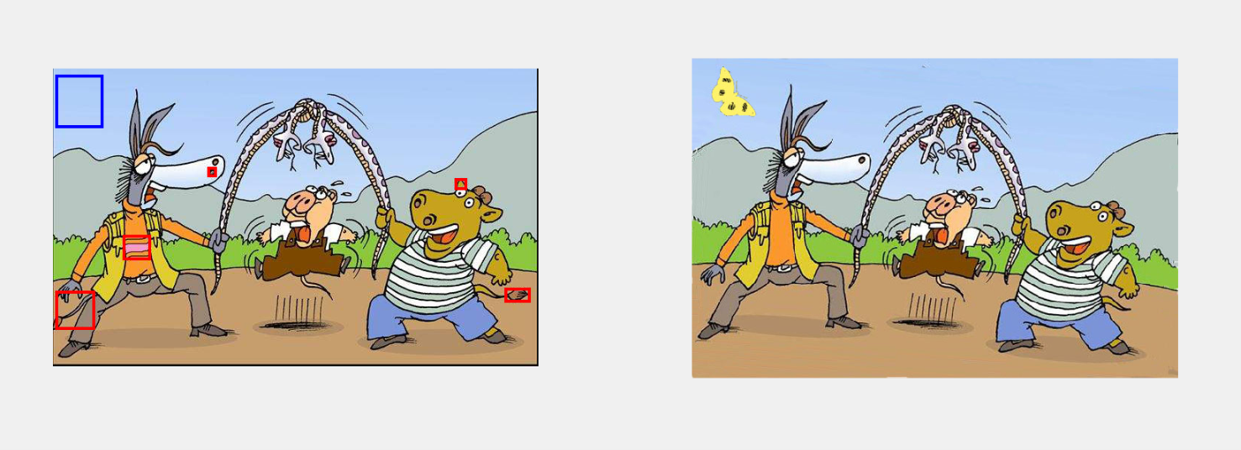
Target Matching

Slide 19
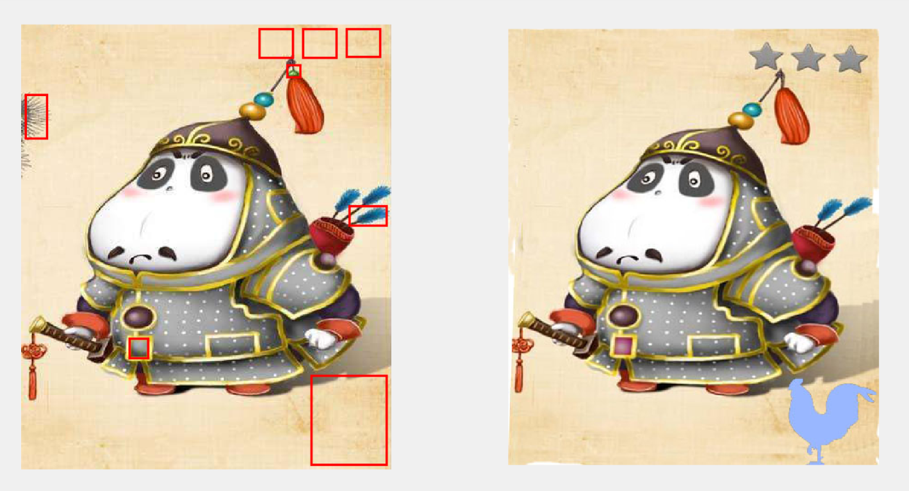
Target Matching

Slide 20
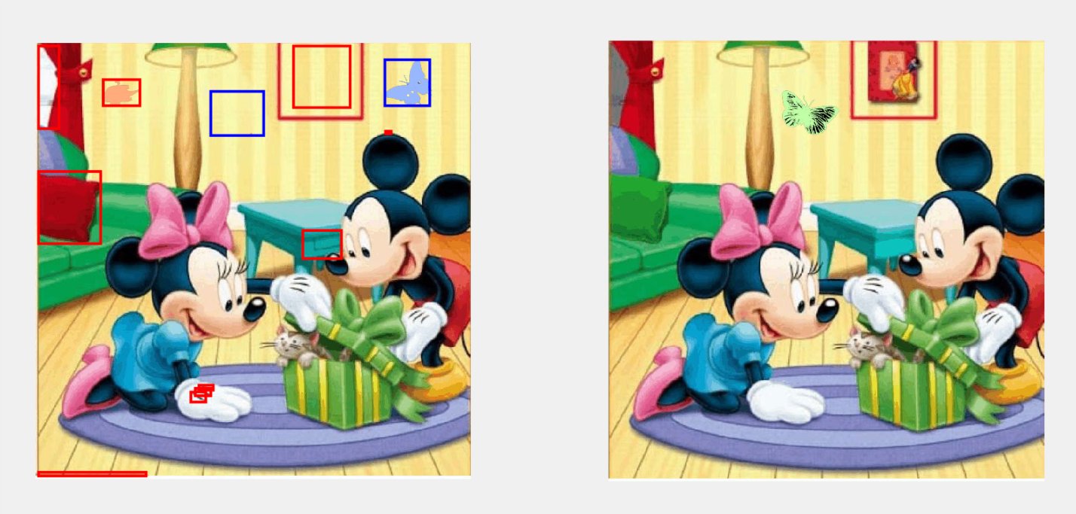
Target Matching

Slide 21
Find Difference Between Images
Problem Analysis
Experimental Procedure
Future Work
Reference

Slide 22
Future Work
Homomorphic Filter is used in this paper ,however ,it’s parameters differ from images to images.
Find the relationship between peaks of histogram and parameters of Homomorphic Filter ,such as Regression Analysis.

Slide 23
Find Difference Between Images
Problem Analysis
Experimental Procedure
Future Work
Reference

Slide 24
Code Release
https://github.com/lishang6257/Find-Different-between-images

Slide 25
Reference
http://www.pi5.com/article-18/785.html
https://blog.csdn.net/yangziluomu/article/details/73528080
https://bbs.csdn.net/topics/390975425
http://www.cnblogs.com/Imageshop/archive/2018/10/10/9766056.html
https://www.cs.ubc.ca/~lowe/keypoints/

Slide 26
Thanks!

